Slide 1

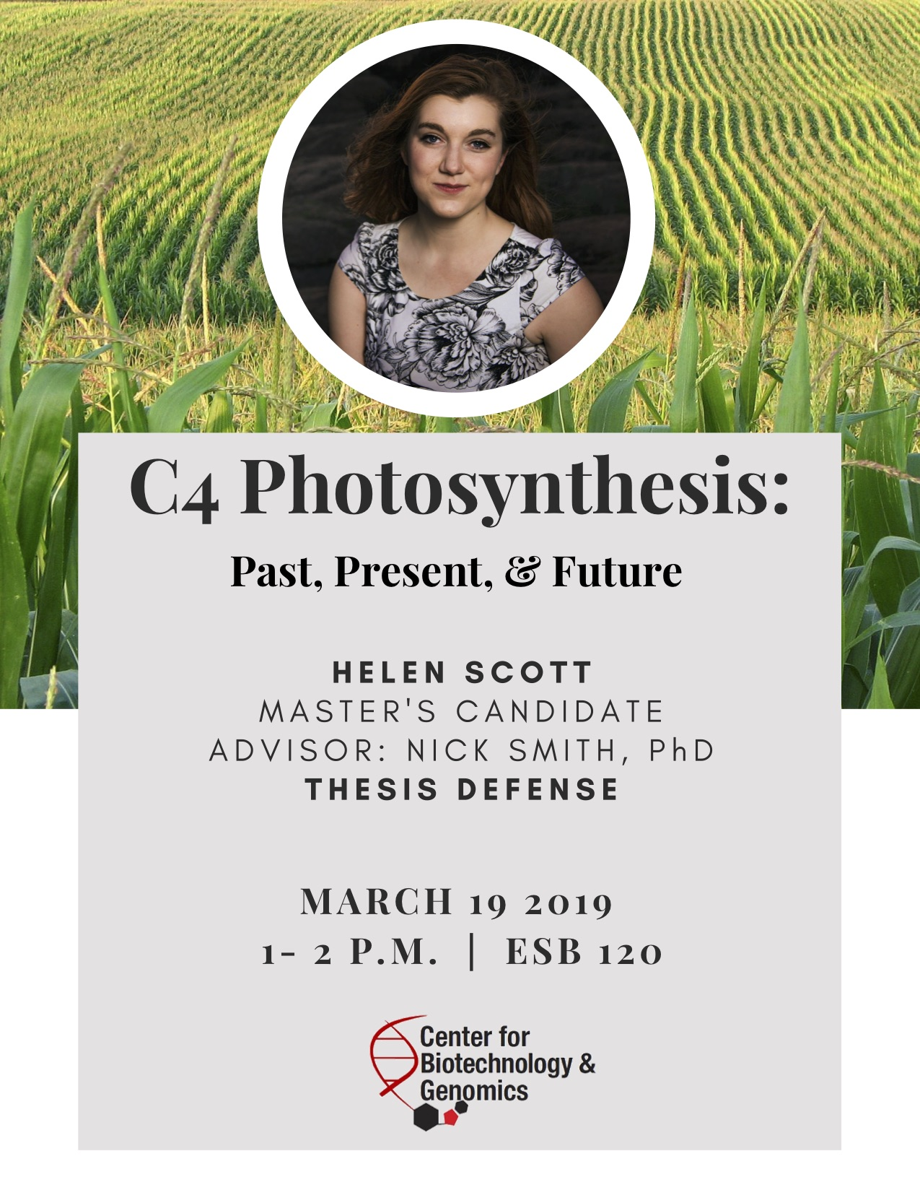
Photosynthetic acclimation through the lens of optimality
Nick Smith
Texas Tech University
nick.smith@ttu.edu; @nick_greg_smith
Lizz Waring
TTU
Helen Scott
TTU
Trevor Keenan
Berkeley Lab
Wang Han
Tsinghua U.
Colin Prentice
Imperial College

Slide 2
Photosynthesis is important!
nick.smith@ttu.edu; @nick_greg_smith

Slide 3
Photosynthesis is important!
nick.smith@ttu.edu; @nick_greg_smith
Data from IPCC (2013)

Slide 4
Photosynthesis is important!
nick.smith@ttu.edu; @nick_greg_smith
Photosynthesis
Data from IPCC (2013)

Slide 5
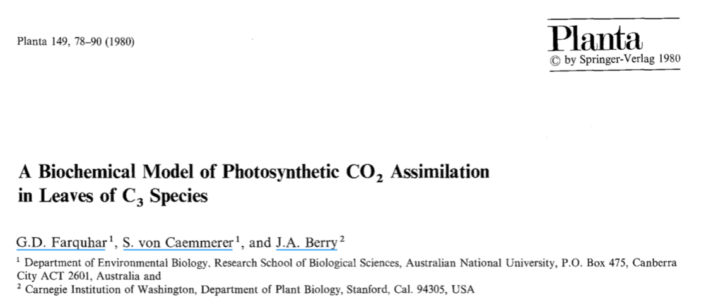
Theoretical models for photosynthesis exist
nick.smith@ttu.edu; @nick_greg_smith

Slide 6
And short-term responses are well known!
nick.smith@ttu.edu; @nick_greg_smith

Slide 7
Long-term responses can differ from short-term responses due to acclimation
nick.smith@ttu.edu; @nick_greg_smith

Slide 8
Long-term responses can differ from short-term responses due to acclimation
nick.smith@ttu.edu; @nick_greg_smith
Acclimated to high light
Acclimated to low light

Slide 9
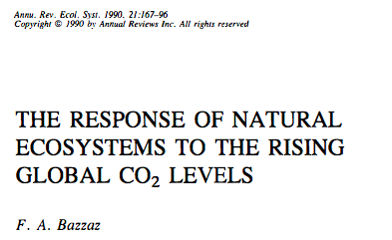
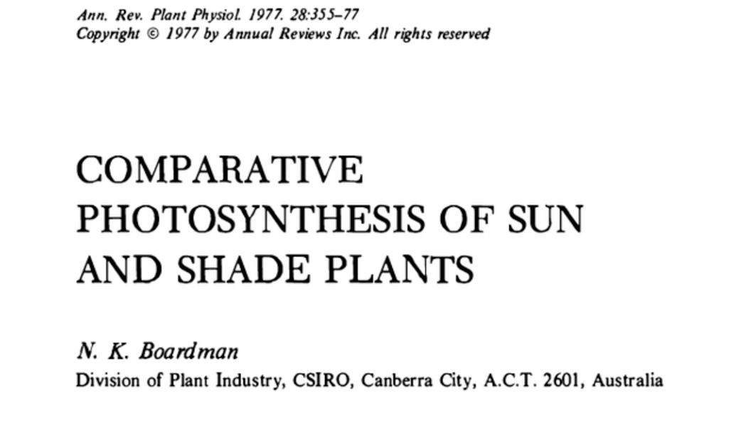
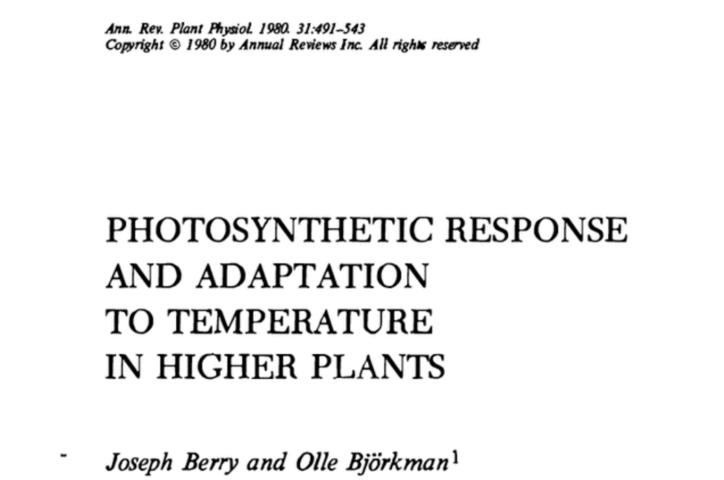
Acclimation is ubiquitous and well known…
nick.smith@ttu.edu; @nick_greg_smith
Temperature: Berry & Björkman (1980)
CO₂: Bazzaz (1990)
Light: Boardman (1977)

Slide 10
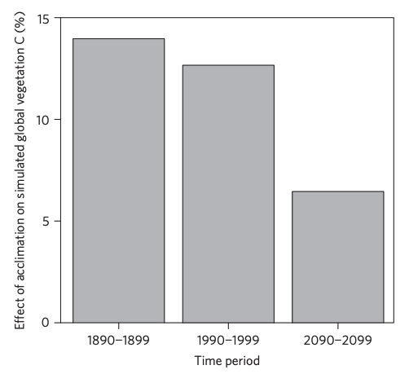
…and can impact carbon cycling and climate…
nick.smith@ttu.edu; @nick_greg_smith
Acclimation increase future C storage by ~6%
Acclimation alters future temperature by >1°C
Smith et al. (2017) Nature Climate Change
Smith et al. (2017) JAMES

Slide 11
…but the mechanisms underlying photosynthetic acclimation are not well known
nick.smith@ttu.edu; @nick_greg_smith

Slide 12
Problem: the mechanisms underlying photosynthetic acclimation are not well known
nick.smith@ttu.edu; @nick_greg_smith

Slide 13
Solution: A testable, theoretical model!
nick.smith@ttu.edu; @nick_greg_smith

Slide 14
Least cost theory
nick.smith@ttu.edu; @nick_greg_smith
Maintain fastest rate of photosynthesis at the lowest cost (water and nutrient use)
Wright et al. (2003) American Naturalist

Slide 15
Biochemistry optimization: Coordination hypothesis
Photosynthesis may be limited by Rubisco carboxylation rate or electron transport rate to regenerate Rubisco
Optimally, plants will coordinate their biochemistry to be equally limited by both rates

Slide 16
Coordination of photosynthesis
nick.smith@ttu.edu; @nick_greg_smith
Optimally…
A_{c} = A_{j}
Electron transport-limited photosynthesis
Carboxylation-limited photosynthesis

Slide 17
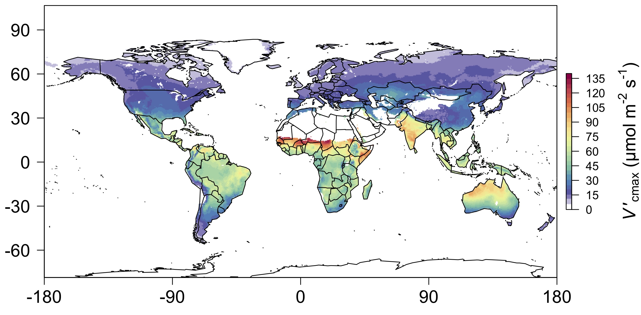
nick.smith@ttu.edu; @nick_greg_smith
We can predict optimal traits in different envionrments
Smith et al. (2019) Ecology Letters

Slide 18
Ok, great, but now what?
nick.smith@ttu.edu; @nick_greg_smith

Slide 19
Let’s tackle some big questions in plant ecophysiology!
nick.smith@ttu.edu; @nick_greg_smith

Slide 20
Question 1: Is photosynthesis optimized to the environment?
nick.smith@ttu.edu; @nick_greg_smith

Slide 21
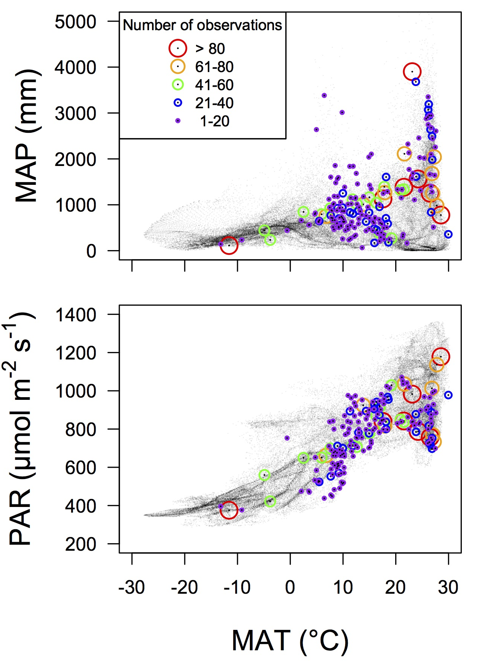
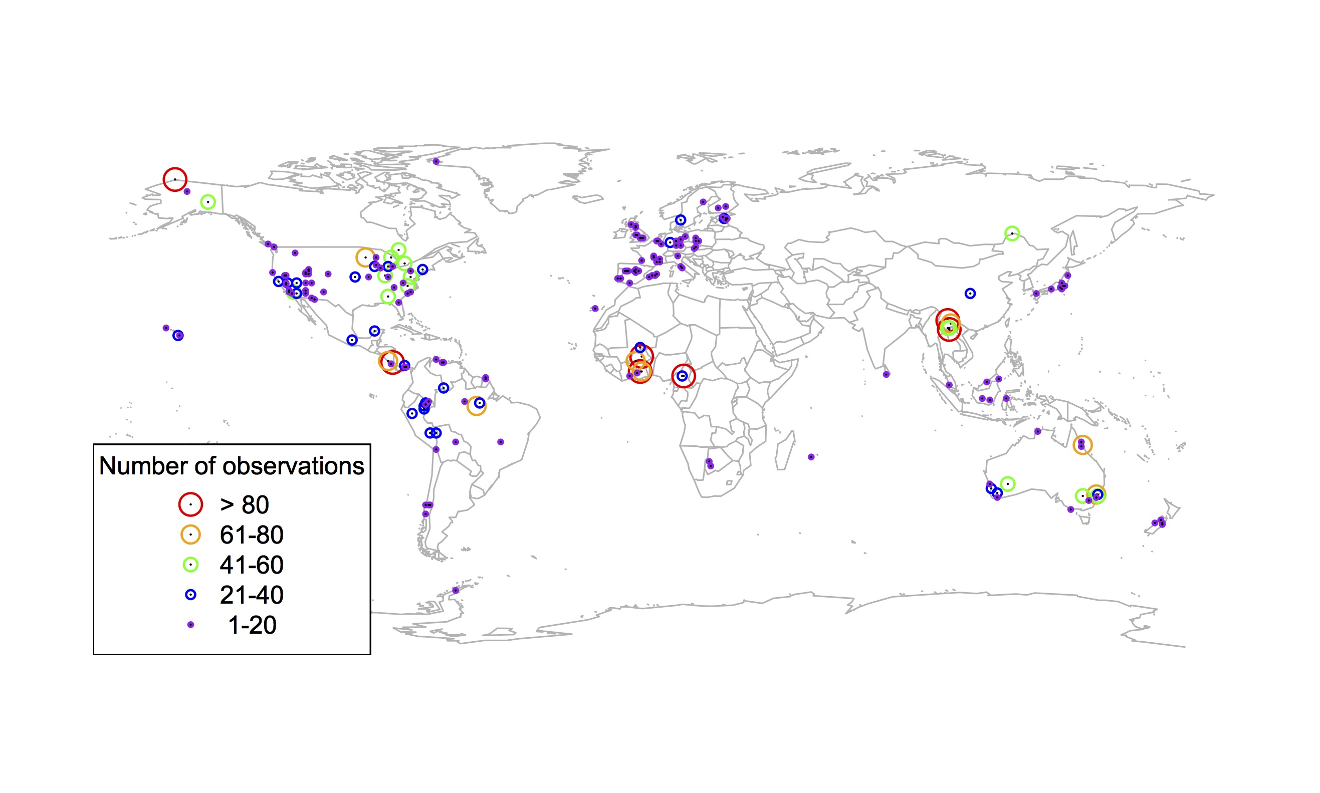
Global V_{cmax} dataset
nick.smith@ttu.edu; @nick_greg_smith
3,697 measurements
202 sites
> 600 genera
Smith et al. (2019) Ecology Letters

Slide 22

nick.smith@ttu.edu; @nick_greg_smith
Smith et al. (2019) Ecology Letters

Slide 23
Question 1: Is photosynthesis optimized to the environment? YES! Photosynthesis acclimates spatially as expected from optimization
nick.smith@ttu.edu; @nick_greg_smith

Slide 24
Question 2: How will photosynthesis acclimate to future conditions?
nick.smith@ttu.edu; @nick_greg_smith

Slide 25
Photosynthetic traits change with temperature and CO₂ in ways expected from optimization
nick.smith@ttu.edu; @nick_greg_smith
Smith and Keenan (in prep)

Slide 26
Photosynthetic traits change with temperature and CO₂ in ways expected from optimization
nick.smith@ttu.edu; @nick_greg_smith
Fully acclimated response
Smith and Keenan (in prep)

Slide 27
Photosynthetic traits change with temperature and CO₂ in ways expected from optimization
nick.smith@ttu.edu; @nick_greg_smith
mean: -12%
mean: -15%
(P > 0.05)
Smith and Keenan (in prep)

Slide 28
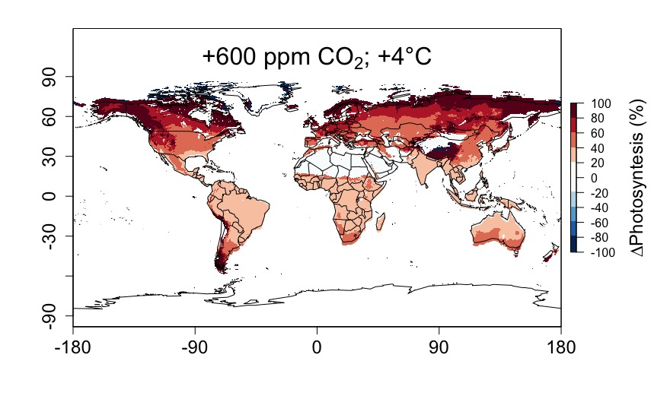
Higher CO₂ and increased temperatures increase future photosynthesis
nick.smith@ttu.edu; @nick_greg_smith
Smith and Keenan (in prep)

Slide 29
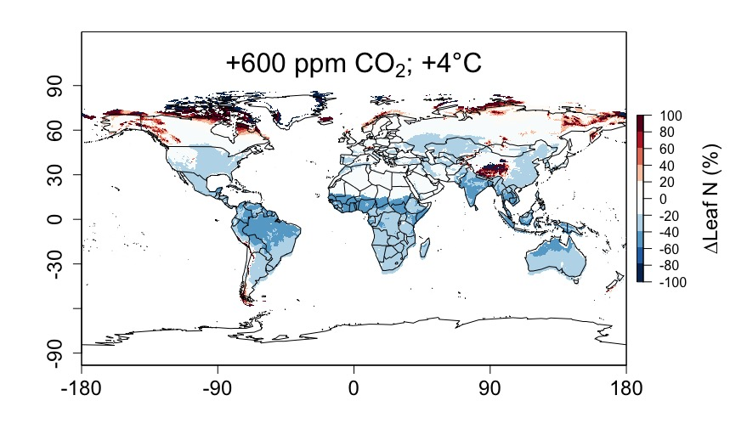
Higher CO₂ and increased temperatures increase future photosynthesis (at lower nutrient use)
nick.smith@ttu.edu; @nick_greg_smith
Smith and Keenan (in prep)

Slide 30
Question 2: How will photosynthesis acclimate to future conditions? Photosynthesis will increase and per-leaf-area nutrient use will decrease
nick.smith@ttu.edu; @nick_greg_smith

Slide 31
Question 3: Does photosynthesis respond to nutrient addition?
nick.smith@ttu.edu; @nick_greg_smith
Lizz Waring
TTU

Slide 32
From the least cost hypothesis…
nick.smith@ttu.edu; @nick_greg_smith
Added nutrients will not increase photosynthesis because light limitation will kick in

Slide 33
From the least cost hypothesis…
nick.smith@ttu.edu; @nick_greg_smith
Added nutrients will not increase photosynthesis because light limitation will kick in
Optimal response would be to increase leaf area

Slide 34
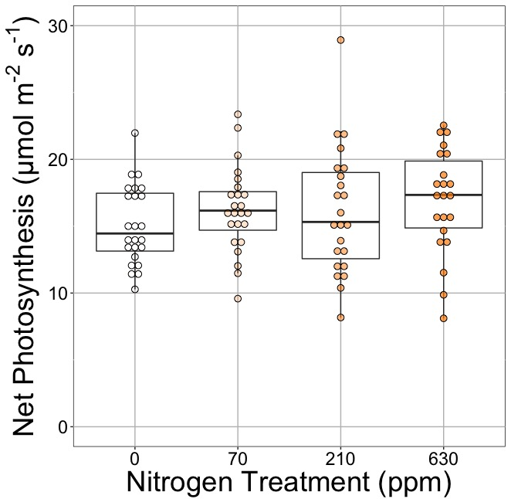
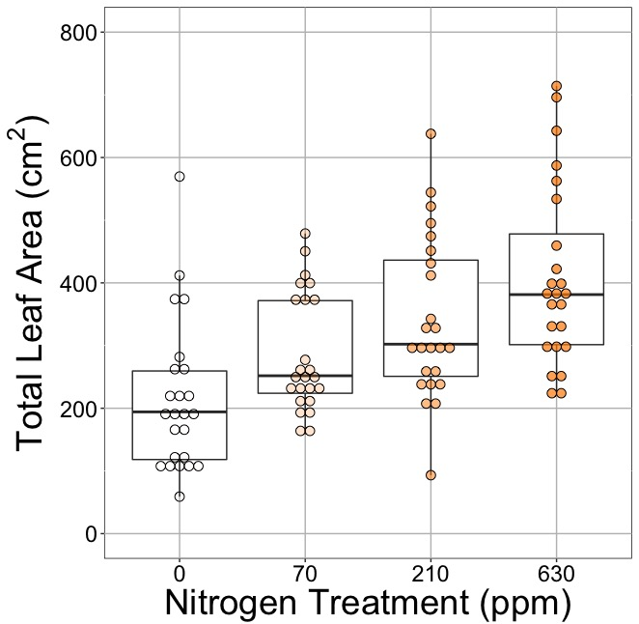
Leaf area, but not photosynthesis increases with N addition
nick.smith@ttu.edu; @nick_greg_smith
Waring and Smith (in prep)

Slide 35
Leaf area, but not photosynthesis increases with N addition
nick.smith@ttu.edu; @nick_greg_smith
Waring and Smith (in prep)

Slide 36
Leaf area, but not photosynthesis increases with N addition
nick.smith@ttu.edu; @nick_greg_smith
Waring and Smith (in prep)

Slide 37
But do greenhouse experiments translate to the field?

Slide 38
Grassland soil nutrient addition network:
Leaf area index
Per-leaf-area nitrogen (photosynthetic proxy)

Slide 39
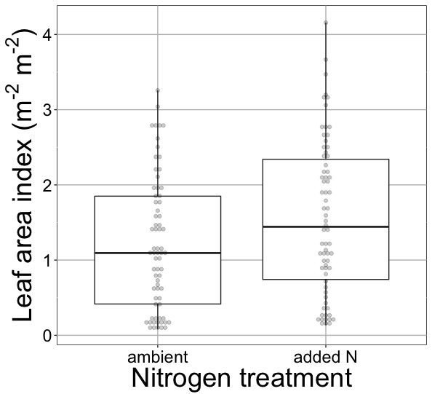
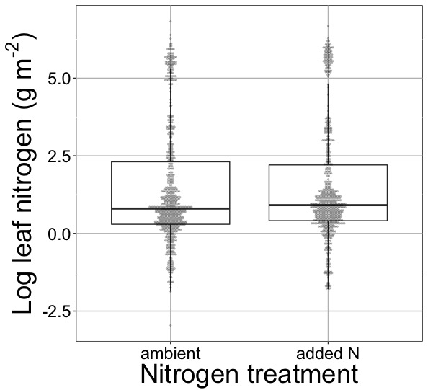
Globally, N addition increases leaf area, not leaf N
nick.smith@ttu.edu; @nick_greg_smith
41% increase (P < 0.05)
No change (P = 0.42)
Waring and Smith (in prep)

Slide 40
Question 3: Does photosynthesis respond to nitrogen addition? No, plants respond to added nitrogen by increasing leaf area, not photosynthesis
nick.smith@ttu.edu; @nick_greg_smith

Slide 41
Question 4: When is C₄ photosynthesis an advantage over C₃ photosynthesis?
nick.smith@ttu.edu; @nick_greg_smith
Helen Scott
TTU

Slide 42
nick.smith@ttu.edu; @nick_greg_smith
Relative advantage of C₄ physiology
Scott and Smith (in prep)

Slide 43
Question 4: When is C₄ photosynthesis an advantage over C₃ photosynthesis? C₄ is better in hot, dry, low CO₂ environments
nick.smith@ttu.edu; @nick_greg_smith

Slide 44
Conclusions
Theory can be useful!
Improving the reliability of climate models
Acting as a null model for understanding mechanisms

Slide 45
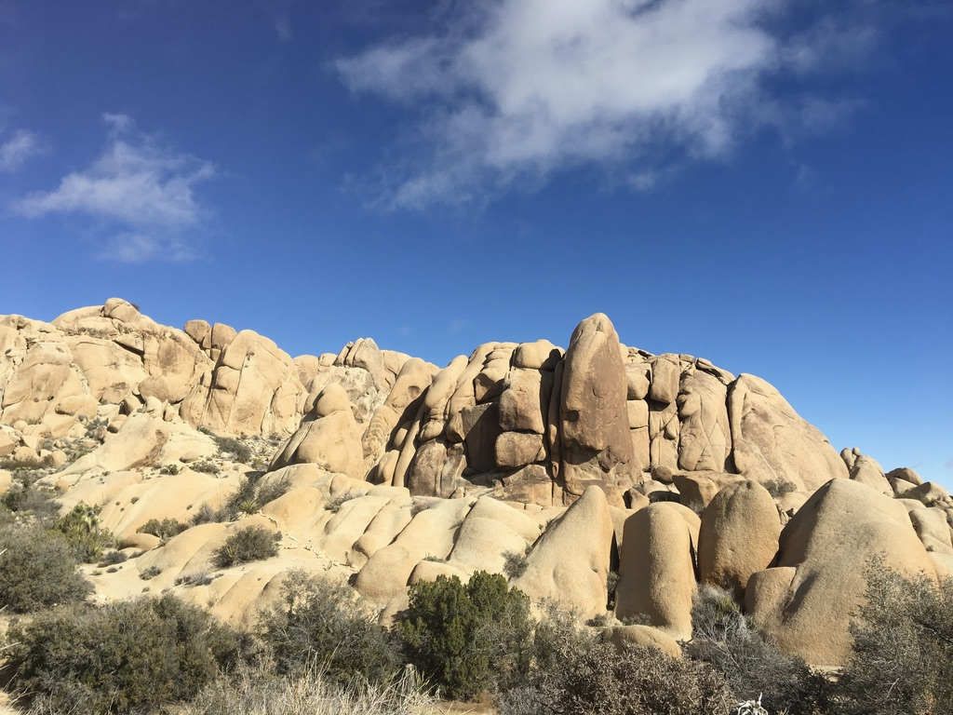
nick.smith@ttu.edu; @nick_greg_smith
Presentation available at:
github.com/SmithEcophysLab/ESA_2019
Thanks!

Slide 46
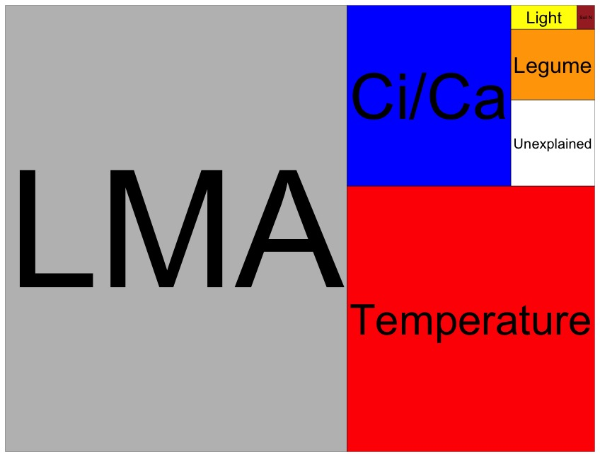
Globally, N addition has no impact on leaf N
nick.smith@ttu.edu; @nick_greg_smith
Each box is proportional to the variance in leaf N explained by each variable
Waring and Smith (in prep)

Slide 47
nick.smith@ttu.edu; @nick_greg_smith
Open stomata:
Benefits
High CO₂ influx
Costs
High water outflux
Closed stomata:
Benefits
Low water outflux
Costs
Low CO₂ influx

Slide 48
nick.smith@ttu.edu; @nick_greg_smith
Open stomata:
Benefits
High CO₂ influx
Costs
High water outflux
Closed stomata:
Benefits
Low water outflux
Costs
Low CO₂ influx
Must maintain high amount of Rubisco to do photosynthesis

Slide 49
Optimal stomatal conductance
nick.smith@ttu.edu; @nick_greg_smith
Optimal conductance maximizes photosynthesis at least water loss and nutrient use
Water loss is from transpiration
Nutrient use is nutrients used to maintain Rubisco
Rubisco proxy is V_{cmax}

Slide 50
Stomatal openness determines χ
nick.smith@ttu.edu; @nick_greg_smith
χ = internal leaf CO₂ / external leaf CO₂
χ = c_{i} / c_{a}

Slide 51
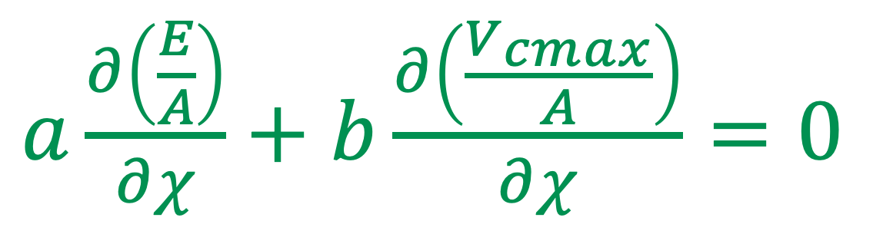
Optimal χ minimizes the costs to maintain transpiration and carboxylation
nick.smith@ttu.edu; @nick_greg_smith
$a\frac{∂\left(\frac{E}{A}\right)}{∂χ}+$ $b\frac{∂\left(\frac{V_{cmax}}{A}\right)}{∂χ}=0$
Cost factor for transpiration (E)
Cost factor for
Rubisco (V_{cmax})
Prentice et al. (2014) Ecology Letters

Slide 52
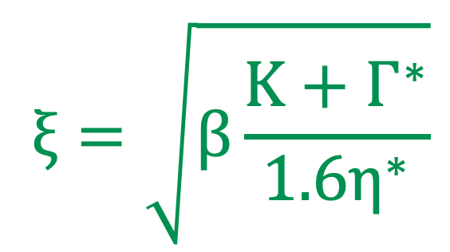
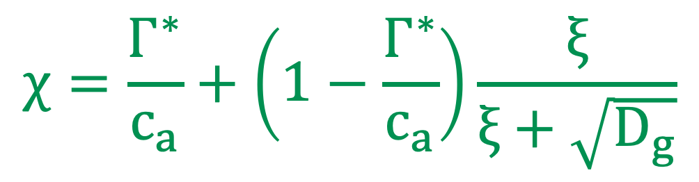
Optimal χ mathmatically
nick.smith@ttu.edu; @nick_greg_smith
$$χ=\frac{Γ^{∗}}{c_{a}}+\left(1−\frac{Γ^{∗}}{c_{a}}\right)\frac{ξ}{ξ+\sqrt{D_{g}}}$$
$$ξ=\sqrt{β\frac{K+Γ^{∗}}{1.6η^{∗}}}$$
Prentice et al. (2014) Ecology Letters

Slide 53
Optimal χ is a function of the costs and the environment
nick.smith@ttu.edu; @nick_greg_smith
χ = f{temperature,
CO₂,
vapor pressure deficit}
Prentice et al. (2014) Ecology Letters; Wang et al. (2017) Nature Plants

Slide 54
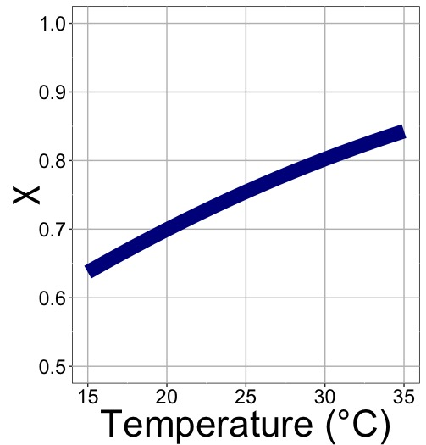
nick.smith@ttu.edu; @nick_greg_smith
χ increases with temperature because of greater photorespiration

Slide 55
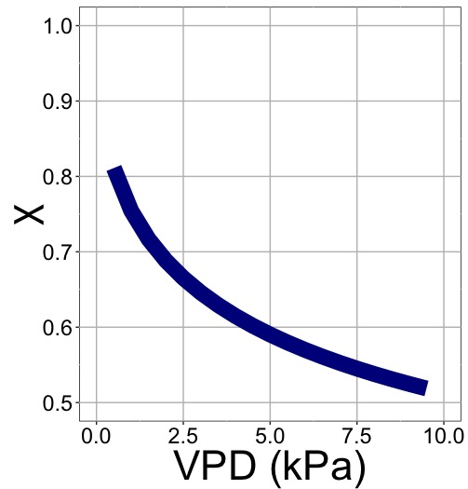
nick.smith@ttu.edu; @nick_greg_smith
χ decreases with VPD because of greater water loss

Slide 56
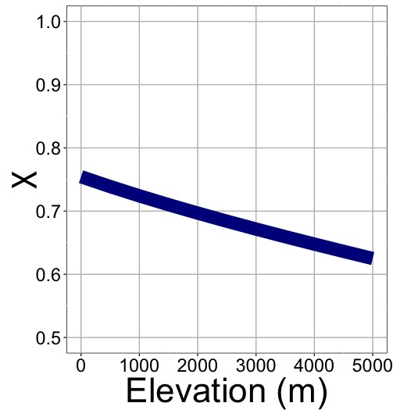
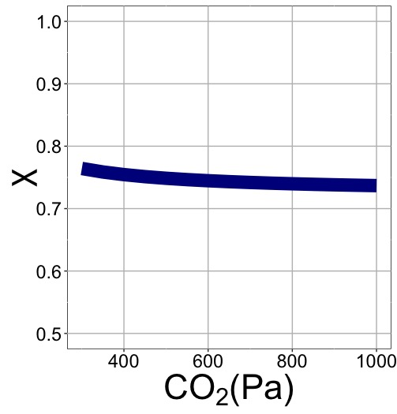
nick.smith@ttu.edu; @nick_greg_smith
χ decreases with elevation because of lower openness needed to satisfy Rubisco

Slide 57
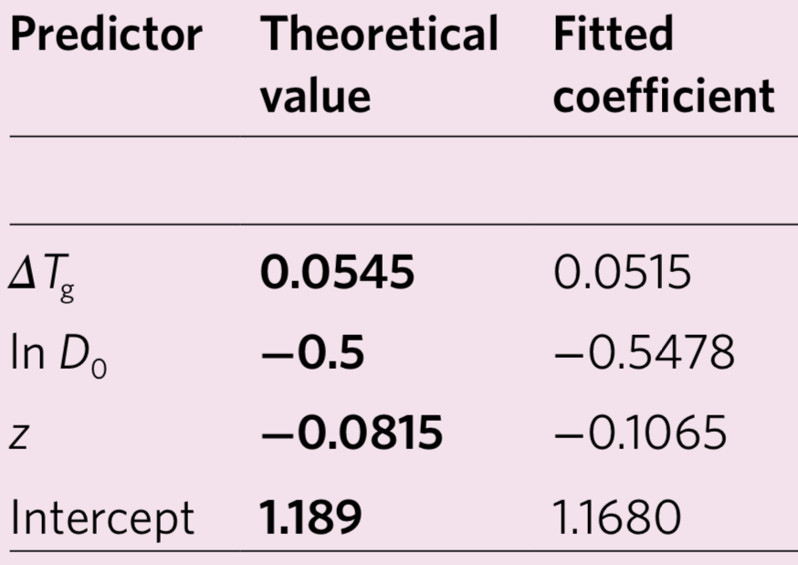
Globally, χ is optimized
nick.smith@ttu.edu; @nick_greg_smith
Wang et al. (2017) Nature Plants

Slide 58
nick.smith@ttu.edu; @nick_greg_smith
χ decreases with elevation because of greater VPD

Slide 59
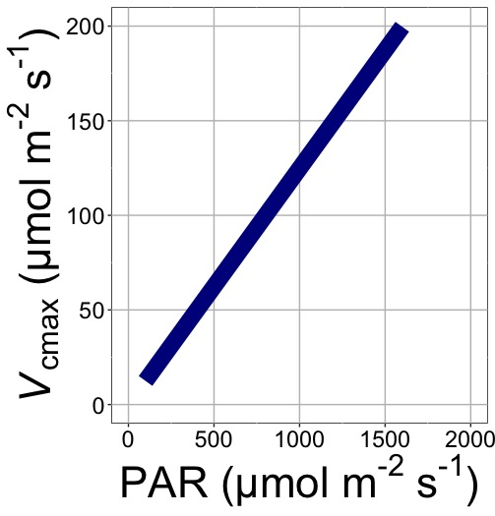
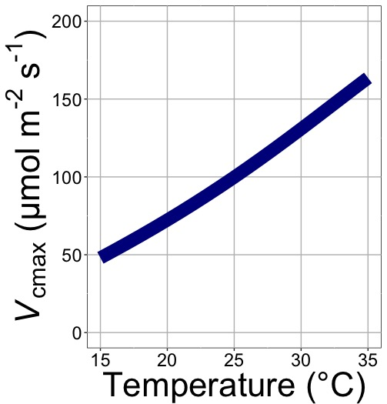
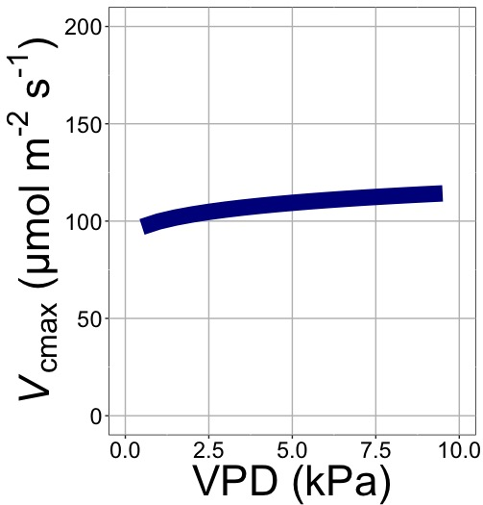
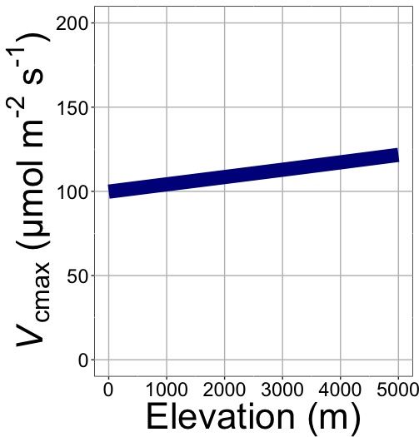
nick.smith@ttu.edu; @nick_greg_smith
V_{cmax} increases with elevation because of lower stomatal conductance
Smith et al. (2019) Ecology Letters

